Slide 1

Compiler Design
Preet Kanwal
Department of Computer Science & Engineering
Teaching Assistant : Lavitra Kshitij Madan

Slide 2

Compiler Design
Unit 1
The Phases of a Compiler
Preet Kanwal
Department of Computer Science & Engineering

Slide 3
Compiler Design Lecture Overview
In this lecture, you will learn about:
C Language Grammar
Running an input through the different phases of a compiler
Syntax Tree versus Parse Tree

Slide 4
Compiler Design
C Language Grammar
To define the Grammar for C Language, let us first define the following:
P : Program Beginning
S : Statement
Declr : Declaration
Assign : Assignment
Cond : Condition UnaryExpr : Unary Expression Type : Data type
ListVar : List of variables
X : (can take any identifier or assignment)
RelOp : Relational Operator

Slide 5
Compiler Design
C Language Grammar
P S
→ S
→ Declr; S | Assign; S | if (Cond) {S} S | while (Cond) {S} S |
if (Cond) {S} else {S} S | for (Assign; Cond; UnaryExpr) {S} S | return E; S | λ
→ Type ListVar
→ int | float
Declr Type ListVar X
Assign Cond RelOp UnaryExpr
→ X | ListVar, X
→ id | Assign
→ id = E
→ E RelOp E
→ < | > | <= | >= | == | !=
→ E++ | ++E | E-- | --E
Recall that
E -> E + T | E – T | T
T -> T * F | T / F | F F -> G ^ F | G
G -> ( E ) | id | num

Slide 6
Compiler Design
Another example for all phases of a compiler
Example 1 : Consider the following piece of code:
while (number > 0)
{
factorial = factorial * number;
--number;
}
We will now run this code through the different phases of a compiler and see what the output will be at each stage.

Slide 7
Compiler Design Example 1 (continued)
Phase 1 : Lexical Analysis or Linear Analysis or Scanner
Pattern | Lexemes matched
Keyword | while
Identifier | number, factorial
RelOp (<, <=, >, >=, ==, !=) | >
LogOp (&&, ||, ~)
Assign (=) | =
ArithOp (*, +, -, /) | *
Punctuation ( (, ), {, }, [, ], ;) | ( ) | { | ; | ; | }
Number | 0
Literal – anything in double quotes
Inc_op
Dec_op | --
while (number > 0)
{
factorial = factorial * number;
--number;
}

Slide 8
Compiler Design Example 1 (continued)
Output: tokens < keyword, while > < punctuation, ( > < ID, 3 > | or |  | < ( >
< RelOp, > > | or | < > | >
< Number, 0 >
< punctuation, ) > |  | or | < ) >
< punctuation, { > |  | or | < { >
< ID, 4 >
< Assign, = > | or | < = | >
< ID, 4 >
< ArithOp, * > | or | < * | >
< ID, 3 >
< punctuation, ; > |  | or | < ; >
< Dec_op, -- > | or | < -- >
< ID, 3 >
< punctuation, ; > | or |  | < ; >
< punctuation, } > | or |  | < } >
< ID, 3 > corresponds to the third identifier in the symbol table
while (number > 0)
{
factorial = factorial * number;
--number;
}

Slide 9
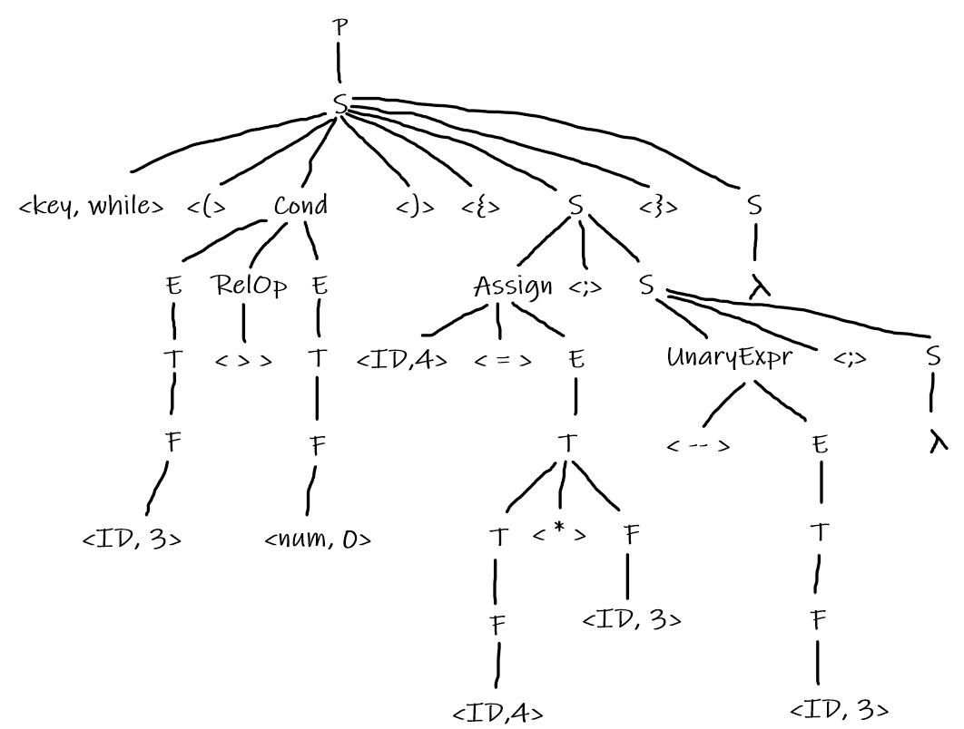
Compiler Design Example 1 (continued)
Phase 2 : Syntax Analysis or Parser Output: Parse Tree or Syntax Tree
Use the grammar we have defined earlier
while (number > 0)
{
factorial = factorial * number;
--number;
}

Slide 10
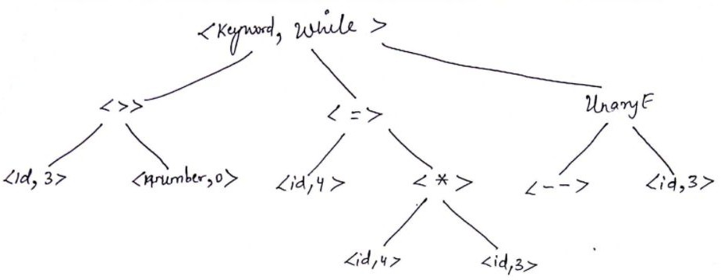
Compiler Design Example 1 (continued)
Phase 3 : Semantic Analyzer
Output: Semantically checked Syntax Tree
while (number > 0)
{
factorial = factorial * number;
--number;
}

Slide 11
Compiler Design Example 1 (continued)
Phase 4 : Intermediate Code Generator Output: Three Address Code (3AC or TAC)
L0 : If number > 0 goto L1
goto L2
L1 : t1 = factorial * number factorial = t1
t2 = number – 1 number = t2 goto L0
L2 : …
while (number > 0)
{
factorial = factorial * number;
--number;
}

Slide 12
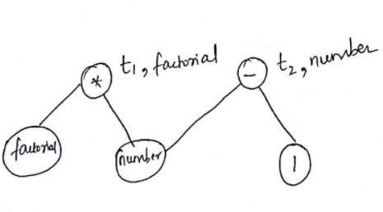
Compiler Design Example 1 (continued)
Phase 5 : Machine Independent Code Optimization Output: DAG Optimization
L0 : If number > 0 goto L1
goto L2
L1 : factorial = factorial * number number = number – 1
goto L0 L2 : …
while (number > 0)
{
factorial = factorial * number;
--number;
}

Slide 13
Compiler Design Example 1 (continued)
Phase 6 : Code Generator Output: Assembly Code
LD R1, #0
L1 : LD R4,number SUB R2, R1, R4 BLTZ R2, L2
LD R3, factorial MUL R3, R3,R4
ST factorial, R3 SUB R4, R4, #1
ST number, R4 BR L1
L2:
L0 : If number > 0 goto L1
goto L2
L1 : factorial = factorial * number number = number – 1
goto L0 L2 : …
while (number > 0)
{
factorial = factorial * number;
--number;
}
Phase 7 : Machine dependent Optimized Code Output: Optimized Target Code

Slide 14
Compiler Design Example 2
Example 2 : Consider the following piece of code:
int rhs, lhs = 0; rhs = 2;
if (lhs <= rhs)
{
lhs = lhs – 2 * rhs;
}
Run this code through the different phases of a compiler and produce the output at each stage.

Slide 15
Compiler Design
C Language Grammar
→ S
→ Declr; S | Assign; S | if (Cond) {S} S | while (Cond) {S} S |
if (Cond) {S} else {S} S | for (Assign; Cond; UnaryExpr) {S} S | return E; S | λ
→ Type ListVar
→ int | float
P S
Declr Type ListVar X
Assign Cond RelOp UnaryExpr
→ X | ListVar, X
→ id | Assign
→ id = E
→ E RelOp E
→ < | > | <= | >= | == | !=
→ E++ | ++E | E-- | --E
Recall that
E -> E + T | E – T | T
T -> T * F | T / F | F F -> G ^ F | G
G -> ( E ) | id | num

Slide 16
Compiler Design
Simple IR Optimizations
Constant folding is the process of recognizing and evaluating constant expressions at compile time rather than computing them at runtime.
Constant propagation is the process of substituting the values of known constants in expressions at compile time.
Common Subexpression Elimination (CSE) is a compiler optimization that searches for instances of identical expressions (i.e., they all evaluate to the same value), and analyzes whether it is worthwhile replacing them with a single variable holding the computed value.

Slide 17
Compiler Design Example 2
Example 2 : Consider the following piece of code:
int rhs, lhs = 0; rhs = 2;
if (lhs <= rhs)
{
lhs = lhs – 2 * rhs;
}
Run this code through the different phases of a compiler and produce the output at each stage.

Slide 18
Compiler Design
Syntax Tree vs Parse Tree
Parse Tree (Concrete Syntax Tree) | (Abstract) Syntax Tree
It is huge and focuses on all lexeme | It focuses only on the syntax
Consists of both Non-terminals (P, S, E, Cond, RelOp, etc.) and Terminals (leaf nodes like tokens) | All nodes are tokens; It also has dummy nodes (<body>) to maintain proper syntax
Complicated | No non-terminals; Easy
Has punctuation (; , { } ) | No punctuation symbols

Slide 19
THANK YOU
Preet Kanwal
Department of Computer Science & Engineering
preetkanwal@pes.edu

